Slide 1
Preparing for your visit to Newhaven Fort
Notes:
About this resource: This Presentation is to help you prepare for you and your pupils for your visit to Newhaven Fort.
Newhaven Fort story: Newhaven Fort is the last of a long series of defences built on the cliffs overlooking Seaford Bay, dating back to the Iron Age.
The site you see today was started in 1862 and was the vision of a young Lieutenant in the Royal Engineers called John Charles Ardagh. It took ten years and six million bricks to complete. There were several novel design features; the first mass use of concrete in a military fortification, a new type of drawbridge and the fact that it was built into the contours of the land, rather than being built above ground like a traditional fort or castle.
At the end of the 19th Century the Fort needed updating and was practically rebuilt. New modern guns were installed and amongst other things, baths were installed for the soldiers. When the First World War broke out the harbour assumed even greater importance, shipping six million tons of supplies to France and the Fort became part of a larger network of defences that included gunboats, thousands of soldiers and a seaplane base in Seaford Bay.
When war broke out 1939, Newhaven Fort was a vital element in the defence against the very real threat of German invasion. Thousands of soldiers were stationed in the area, including many Canadians who took part in the ill-fated Dieppe Raid from Newhaven. Troops also set out here for the Normandy landings of 1944

Slide 2
A Grand Entrance
When you arrive at the Fort you will walk through the tunnel entrance onto the Parade Ground.
You will then go to the Activity Centre or Romney Hut - depending on how many of you there are!
Notes:
Arrival
When you arrive at the Fort your group will come through the tunnel entrance onto the Parade Ground. You will be met by fort staff who will direct you to the room you will use as your base for the day.
If you have booked object handling workshops they will take place in the Activity Centre. If you have booked a Discovery visit you will have your introductory talk in the Activity Centre or Romney Hut (depending on the number of pupils in your group).

Slide 3
What will you see?
The Tea Room, Shop, and Children’s Play Area are all located in and around the Parade Ground.
You can explore the ramparts to enjoy the views of Seaford Bay and the South Downs – and see our big 6-Inch gun!
Exhibitions
These are housed in the rooms that run around the edge of the Parade Ground and in the Grand Magazine – the Fort’s original gunpowder store.
Notes:
What to see:
Newhaven Fort has a variety of exhibitions telling the story of the fort, the site it sits on and the local area. There are also exhibitions dedicated to the two World Wars and collections belonging the Royal Observer Corps Association and the Sussex Yeomanry Association. Most of the exhibition rooms are alongside the Parade Ground in the casemates (see next slide!) but there are also two exhibitions in the Grand Magazine.
As well as exhibitions we have ramparts and tunnels to explore. The ramparts can be accessed from various points, including via the 6-Inch gun emplacement. Please note that the gun emplacement only has stepped access, but you can reach the clifftop via a path the Battery Observation Post.
The Café, Shop, Toilets and Children’s Play Area are all located in and around the Parade Ground.

Slide 4
What is a Casemate?
A casemate is a vaulted chamber (a room with an arched ceiling) used for accommodation or storage.
The casemates at the fort run along two sides of the Parade Ground and were originally used as barrack rooms and stores for the soldiers stationed here. Now they contain exhibitions as well as the Shop and Activity Centre (education room).
Notes:
Casemates: the casemates were vaulted chambers which were used to house men and stores at Newhaven Fort. The casemates at the Fort run all along the Parade Ground and now contain the exhibitions as well as the Shop and Activity Centre (education room).
The shop was originally the Guard Room. Everybody who arrived at the Fort reported here, and it also contained two cells for soldiers who misbehaved! The room next to the shop, which is now the Fort office, was the Orderly Room. This was the administrative centre of the fort, much like it is today. But with fewer computers…
The casemates from the Theatre up to the Activity Centre were barrack rooms for the soldiers (16 men in each) and from Sussex Sea & Air to Dieppe & D-Day were the married men’s quarters. The casemate that now houses the Home Front exhibition was the Quartermaster’s Store, from where soldiers would collect supplies of food and uniform.
The casemates that now house the First World War exhibition were originally the Officers’ Quarters and Officers’ Mess Room (dining hall).
All of the casemates would originally have had porches like you see on the First World War exhibition (top picture of this slide) and Dieppe & D-Day exhibitions.

Slide 5
The Exhibitions
The exhibitions at the Fort will tell you about the history of the fort, the site it sits on and life in Britain during two World Wars – there’s lots to look out for!
Notes:
The history of fortifications on Castle Hill (the name of the cliff on which the Fort stands) goes right back to the Iron Age and you can find out more about this and the prehistory of the Ouse River Valley in The Lost Fort exhibition. Information on the history of the Fort itself and life in the Victorian Army can be found in the History of the Fort and Life in the Fort exhibitions.
Information about the Great War is found in the First World War exhibition.
D-Day & Dieppe: The ill-fated Dieppe raid of 1942 and the Normandy landings of 1944 have particular relevance to the story of Newhaven’s Second World War.
Explore the town’s involvements with these momentous events, discover why the Canadian involvement in the Dieppe Raid is still remembered today and listen to the poignant memories of the survivors.
Life for ordinary people in World War Two is very clearly shown in the Home Front exhibition. See next slide.

Slide 6
Home Front Exhibition
The Second World War had a massive impact on everyday life in Britain.
In the Home Front exhibition, you will learn about:
The impact of the war on Newhaven
The important role that women played in the war effort
Rationing
The Home Guard
Air raids
The aftermath of war
Notes:
Home Front exhibition: You can’t tell the story of the Second World War without mentioning the impact it had on everyday life in Britain, and this exhibition, one of the biggest at Newhaven Fort, does just that.
There is much to experience here. You can walk through a blitzed street and see how people tried to protect themselves and their homes. You can also listen to local people retelling their wartime experiences, discover the changing role of women, learn about the many restrictions on civilian life, consider what it was like to be an evacuee, and see how little you would have to eat – but at least the diet was healthy!

Slide 7
The Air Raid
Experience for yourself the sounds and sensations of a Second World War air raid in our recreated public shelter.
But don’t panic – it isn’t real. Our air raid is narrated, and this very rarely happened during the war!
Listen to the narration and you’ll find out about all the people who would be putting themselves at risk by helping others during a raid. What a brave bunch they were!
Notes:
The Air Raid Experience can be found at the back of the Home Front Exhibition. You can do this whenever you like and as many times as you like – just press the green button and take a seat….
Our shelter represents a public shelter, such as would have been found in may towns and cities - and even in many schools. Many children in wartime would have sat in an air raid shelter with their classmates and teachers, waiting for the danger to pass. The difference for you is that you know it’s not real! Imagine how scary it would be if you thought bombers may really be on their way.
Our air raid lasts for around 5 minutes, it goes dark very briefly and it does have a very loud bang!
Oh, by the way, look out for the potty. This was the only toilet!

Slide 8
Fort Film Shows
There are two fabulous films to watch here at the fort...
The Wonderfully Wide-screen Introductory Film
A seven-and-a-half minute trip through the history of Newhaven Fort and the site on which it stands.
and
The Hidden Fort show
Join our intrepid tour guide as she ventures into parts of the Fort that are closed to the public.
Notes:
The introductory film is housed in the Theatre and takes you on a fast paced and entertaining journey through the history of the Fort. You’ll discover what was on the site before, why the Fort was built and the ups and downs of its 150 year history.
In the Grand Magazine (the Fort’s original gunpowder store) you’ll find a treat waiting as our tour guide takes you on a trip to parts of the Fort that are no longer accessible to the public. You’ll find out what on earth a B.O.P. is, discover how the Fort would be defended in the event of an attack and unearth some fine 1940s artwork.
And, just so you know, BOP stands for Battery Observation Post – it stands on the highest point of the Fort and was the eyes and ears of the garrison here during its military life.

Slide 9
6 Inch Gun Emplacement
Don’t panic! This isn’t a tiny gun. The 6 inch part of the name relates to the size of the shell it fired rather than the length of the gun barrel.
It’s actually very big and the whole gun weighs more than 20 tons!
There were two of these here during the Second World War, along with several smaller guns that you can learn all about when you visit.
Notes:
Gun Emplacements: When the Fort was built it was armed with muzzle loading guns – in other words the shells were loaded down the gun barrel. These were replaced in 1902 by two modern breech loading six-inch guns, with a range of seven miles, and two smaller guns. Today there is one of each of these guns in emplacements on the ramparts. You can find out all about the Fort’s original armaments in the History of the Fort exhibition.
In 1943 a new battery was built on Castle Hill, to the west of the Fort, to replace the guns in the Fort. You can still see the remains of these gun positions if you walk on Castle Hill Nature Reserve.

Slide 10
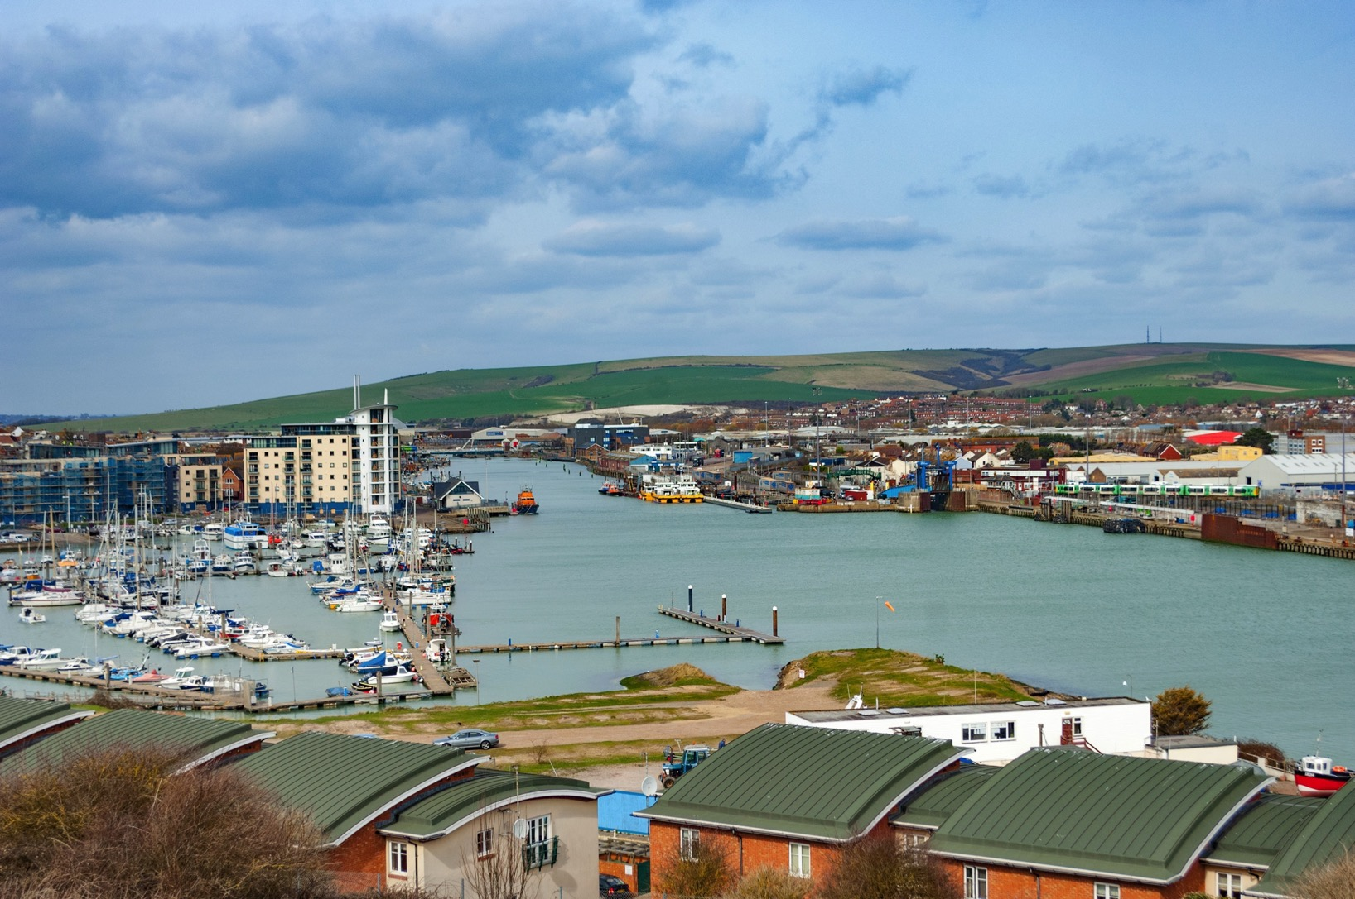
What a View!
As you walk round the ramparts you’ll notice what amazing views we have from the fort.
With views like these it’s not surprising that this site was chosen to to defend against the threat of naval attack.
Notes:
Fort & Newhaven: Newhaven was an important port and still is today. What types of boats can you see in the picture? Do you think it would have been similar in Victorian times when the Fort was built? And what about during the First and Second World Wars?
Why do you think did Lt Ardagh (the man who designed the Fort) chose this site to build his fort on?

Slide 11
Going Underground
Steps lead down through the cliff to the Caponier which was a defensive position that covered the beach and the line of the cliffs.
You can also explore the old ammunition stores in the Eastern Magazine (that’s magazine in the military sense, not like a shiny newspaper…)
Notes:
Caponier: Steps led down through the cliff to the Caponier which was a defensive position that defended the beach and the line of the cliffs. If the Fort came under attack by sea, soldiers from inside the Fort could hurry down the steps to fire at invading troops through narrow windows cut into the thick brick walls. It is also where the fort’s ghost is said to reside. You can find out more about the Caponier in the History of the Fort exhibit and the Hidden Fort film.
What is the Eastern Magazine? What does magazine mean? Magazine is the name for a place where ammunition or explosive material is stored, and this one is on the eastern side of the Fort – hence Eastern Magazine. Easy really. You can walk through the old magazine and explore the narrow lighting passages that run behind the storage rooms. There are no exhibition rooms in the magazine as it is only accessible via flights of steps at either end, but it’s fun to explore!

Slide 12
See you soon!!
So that’s what you can expect at Newhaven Fort.
We can’t wait to meet you!
0

